Slide 1
The Kernel Tricks for Support Vector Machines

Slide 2
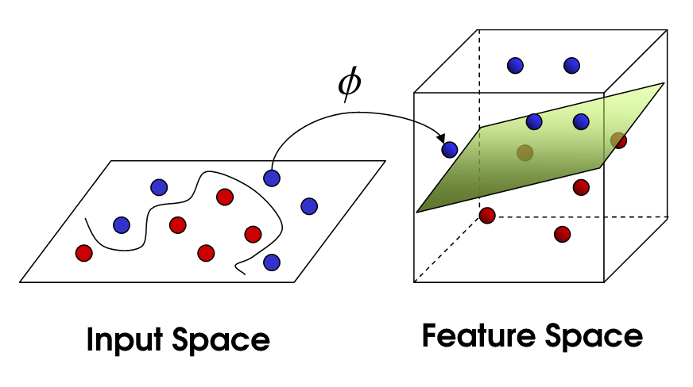
Understanding Kernel Trick
Two classes of observations: the blue points and the purple points.
There are tons of ways to separate these two classes as shown in the graph on the left.

Slide 3
How to find best Hyperplane?
To find the “best” hyperplane that could maximize the margin between the hyperplane and the nearest data points on each side is the largest.
Depending on which side of the hyperplane a new data point locates, we could assign a class to the new observation.

Slide 4
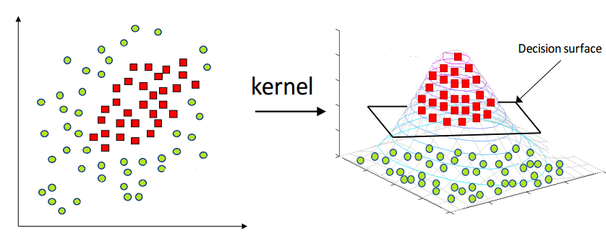
Understanding Kernel Trick
Not all data are linearly separable.
To map the data from 2-dimensional space to 3-dimensional space, we will be able to find a decision surface that clearly divides between different classes.

Slide 5
Kernel Trick
When there are more and more dimensions, computations within that space become more and more expensive. This is when the kernel trick comes in.
Allows us to operate in the original feature space without computing the coordinates of the data in a higher dimensional space.
The application of the kernel trick is not limited to the SVM algorithm. Any computations involving the dot products (x, y) can utilize the kernel trick.

Slide 6
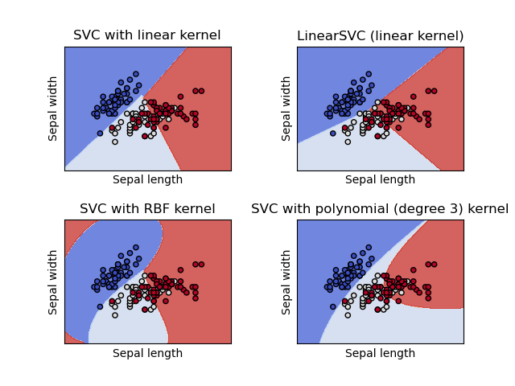
Types of Kernels
Linear Kernel
Polynomial Kernel
Radial Basis Function (RBF) kernel

Slide 7
Key takeaway points
When we map data to a higher dimension, there are chances that we may overfit the model.
Thus choosing the right kernel function ,including the right parameters and regularization are of great importance.

